Slide 1
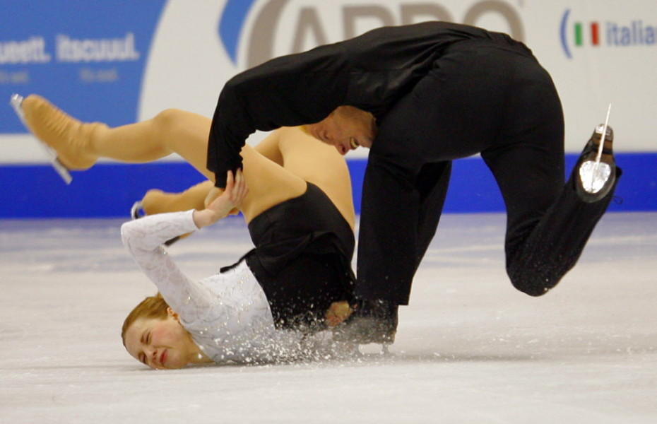
Concussions:
What You Need to Know
Tad Seifert, MD
Director, Sports Concussion Program, Norton Healthcare
Clinical Assistant Professor of Neurology, University of Kentucky
Member, Kentucky State Boxing Commission
Head, NCAA Headache Task Force
Notes:
1

Slide 2

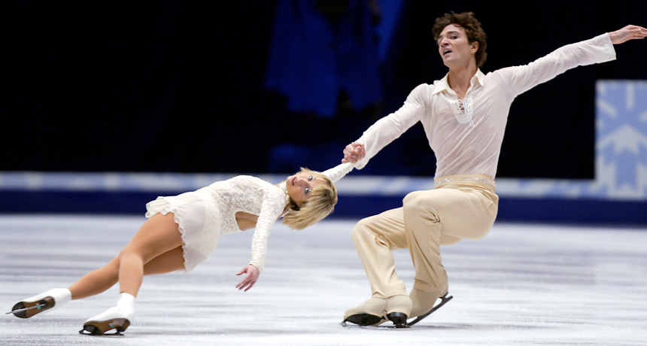
Overview of Concussion Management
Definition
Prevention
Recognition/Diagnosis
Management
Return to school
Return to play (skate)

Slide 3

The Most Complex Object in the Universe
http://en.wikipedia.org/wiki/Christof_Koch
http://www.npr.org/2013/06/14/191614360/decoding-the-most-complex-object-in-the-universe
The scale: roughly 100 billion neurons, each with ~ 7,000 synaptic connections resulting in highly compact and integrated system of roughly…

Slide 4
The Most Complex Object in the Universe
http://en.wikipedia.org/wiki/Christof_Koch
http://www.npr.org/2013/06/14/191614360/decoding-the-most-complex-object-in-the-universe
The scale: roughly 100 billion neurons, each with ~ 7,000 synaptic connections resulting in highly compact and integrated system of roughly…
… 1 quadrillion connections

Slide 5
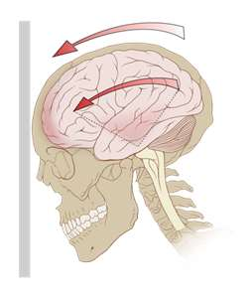
What Causes a Concussion?
Characteristics needed to sustain a concussion include:
  Rotational, Angular, and/or Lateral forces causing rotation of the brain around the upper brainstem.
  A direct blow to the head is not required.
Notes:
5
5
Some argue that the terms concussion and MTBI should not be used together as Sports Related Concussion can sometimes result in severe injury. Zurich felt that there was a difference between concussion and MTBI however did not attempt to define mTBI.
Lack of a uniform definition creates significant issues in performing research studies and in the FDA evaluation of devices used to evaluate sports concussion.

Slide 6
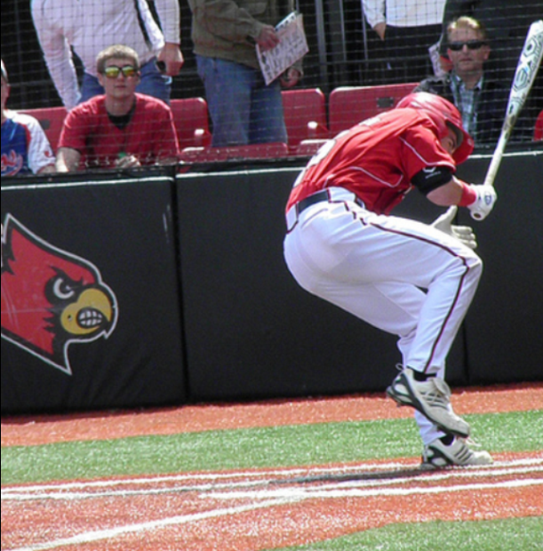
Overview
Sports Concussion
1.6 – 3.8 million sports and recreation-related concussions occur annually
Sports account for 21% of all TBI among US children and adolescents
Each year 60K high school athletes sustain concussions

Slide 7

20 sports/recreational activities contributing to the highest number of estimated head injuries treated in U.S. hospital Emergency Rooms in 2009
Cycling: 85,389
Football: 46,948
Baseball and Softball: 38,394
Basketball: 34,692
Water Sports (Diving, Scuba Diving, Surfing, Swimming, Water Polo, Water Skiing, Water Tubing): 28,716
Powered Recreational Vehicles (ATVs, Dune Buggies, Go-Carts, Mini bikes, Off-road): 26,606
Soccer: 24,184
Skateboards/Scooters: 23,114
Fitness/Exercise/Health Club: 18,012
Winter Sports (Skiing, Sledding, Snowboarding, Snowmobiling): 16,948
Horseback Riding: 14,466
Gymnastics/Dance/Cheerleading: 10,223
Golf: 10,035
Hockey: 8,145
Other Ball Sports and Balls, Unspecified: 6,883
Trampolines: 5,919
Rugby/Lacrosse: 5,794
Roller and Inline Skating: 3,320
Ice Skating: 4,608

Slide 8
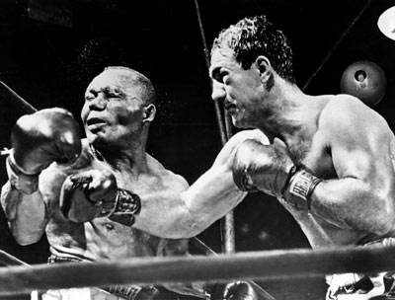
Journal of the American Medical Association
Oct. 13, 1928
“Punch Drunk Syndrome”
  Dr. Harrison Martland
Notes:
8

Slide 9
Study Conclusion:
“There is a very definite brain injury due to single or repeated blows on the head or jaw. The condition can no longer be ignored by the medical profession or the public.”
JAMA 1928
Notes:
9

Slide 10
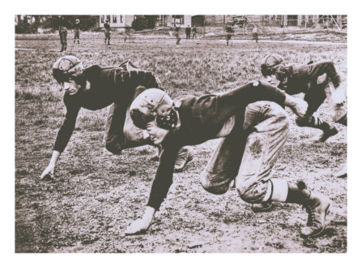
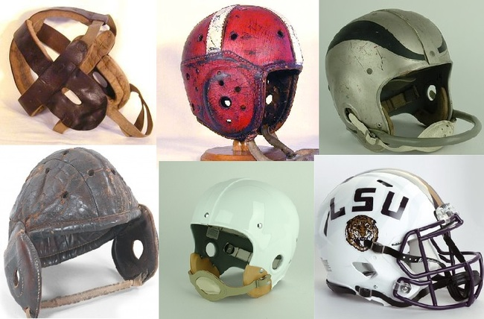

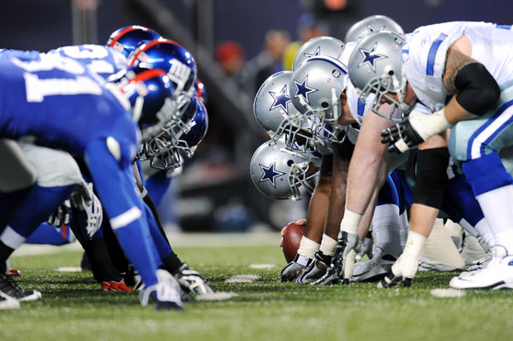
What’s Changed?

Slide 11

Athletes are changing……
University of Alabama’s 1966 undefeated National Championship team:

Slide 12
Athletes are changing……
University of Alabama’s 1966 undefeated National Championship team:
  Only 19 players heavier than 200 lbs

Slide 13
Athletes are changing……
University of Alabama’s 1966 undefeated National Championship team:
  Only 19 players heavier than 200 lbs
  Heaviest player 223 lbs

Slide 14
Athletes are changing……
University of Alabama’s 1966 undefeated National Championship team:
  Only 19 players heavier than 200 lbs
  Heaviest player 223 lbs
  QB weighed 177 lbs

Slide 15

Notes:
15

Slide 16
Notes:
16

Slide 17
Concussion Myths…..
Fact or Fiction??

Slide 18
Concussion: Fact vs. Fiction
Boys get more concussions
Notes:
18

Slide 19
Concussion: Fact vs. Fiction
Boys get more concussions
  FACT
Boys get more concussions because they play more sports with risk for concussion
Notes:
19

Slide 20
Who Gets Sports Concussions?
Lincoln, et al. Am J Sports Med 2011
Concussions (% of Total)
  Football 53%
  Lacrosse (boys) 8%
  Soccer (girls) 7%
  Basketball (girls) 6%
  Wrestling 5%
  Cheerleading 5%
  Soccer (boys) 4%
  Lacrosse (girls) 4%
  Basketball (boys) 3%
  Softball 2%
  Field Hockey 2%
  Baseball 1%
Notes:
20

Slide 21
Fact vs. Fiction
Girls have a higher rate of concussions
Notes:
21

Slide 22
Fact vs. Fiction
Girls have a higher rate of concussions
  FACT
If looking at comparable sports, girls indeed have a higher concussion rate
Notes:
22

Slide 23
Concussions/1000 games
Lincoln, et al. Am J Sports Med 2011
SPORT | BOYS | GIRLS
FOOTBALL | 1.55
SOCCER | 0.59 | 0.97
BASEBALL/ SOFTBALL | 0.04 | 0.08
Notes:
23

Slide 24
Second Impact Syndrome
Catastrophic
After a 1st concussion, a second impact to head
  Rapid deterioration
  Diffuse cerebral edema
  Potentially Death
  If not death, permanent disability
Notes:
The first injury causes loss of cerebral auto regulation that persists. Second injury causes catecholamine surge leading to diffuse cerebral edema.

Slide 25
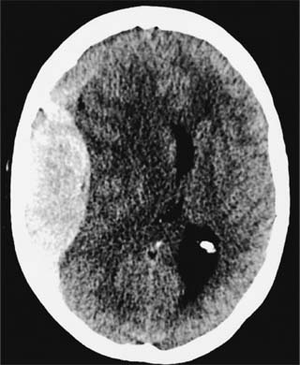
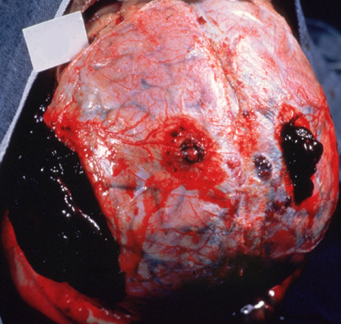
“Second Impact Syndrome” and subsequent epidural hematoma

Slide 26
Fact vs. Fiction
Repeat concussions often cause Second Impact Syndrome
Notes:
26

Slide 27
Fact vs. Fiction
Repeat concussions often cause Second Impact Syndrome
  FICTION
Second Impact Syndrome happens rarely
  50% mortality; 50% morbidity when it does occur
Notes:
27

Slide 28
Recurrent Concussion
After 1st concussion, players are at greater risk
  Selection bias
    Style of play
    Playing time
    Position
  The brain may be more susceptible
    Greatest risk of 2nd concussion during 7-10 days
    3 X more likely to have 2nd concussion in same season

Slide 29
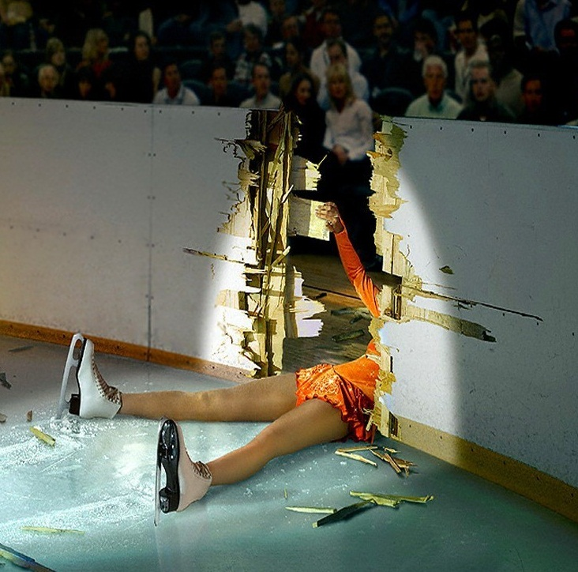
What are we watching for???

Slide 30
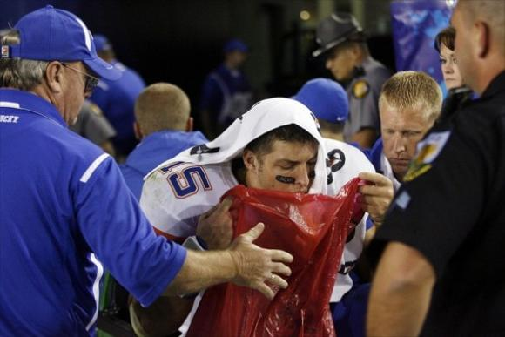
Sequelae of Concussion
Cognitive
  Deficits in attention, memory, executive function
Behavioral
  Irritability, anxiety, depression, apathy
Somatic
  Headache, dizziness, vertigo, sleep disturbances, nausea, light and sound sensitivity, fatigue, etc

Slide 31

What are we watching for???
LOC
Balance following impact
Confusion
Change in behavior

Slide 32
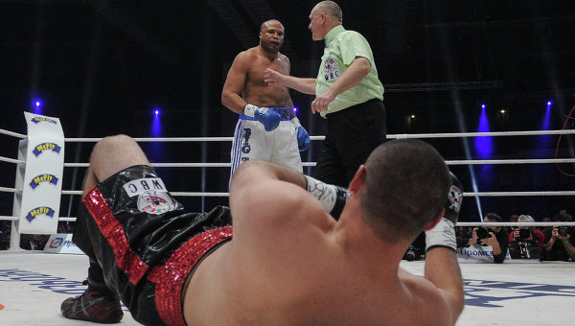
Delayed Symptoms Can Occur….
Be wary of the delayed and recurrent symptoms
Many athletes may seemingly “normalize” within minutes of an injury, but then have a recurrence and potential worsening minutes to hours later

Slide 33
Immediate Post-Injury
Treatment Plan
Guidelines for immediate ER evaluation
  Loss of consciousness
  Seizure activity
  Recurrent vomiting
  Deterioration of neurological function
  Decrease or irregularity of pulse/respiration
  Unequal, dilated, or non-reactive pupils
  Signs/symptoms of associated injuries (i.e. spine/skull fracture)

Slide 34
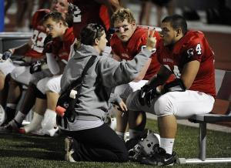
Home Instructions
Immediately Post-Injury
Released only to a responsible adult
  Preferably parent or guardian
Specific home care instructions
  Cognitive Rest
    No video games
    No texting
    No phone usage
    No computer work
    No reading
  Physical rest
  No driving

Slide 35
Home Instructions
Immediately Post-Injury
Released only to a responsible adult
  Preferably parent or guardian
Specific home care instructions
  Cognitive Rest
    No video games
    No texting
    No phone usage
    No computer work
    No reading
  Physical rest
  No driving

Slide 36
Cerebral Steal and Rest
Brain Injury
Increased energy consumption for cellular and metabolic repair
Cerebral steal = energy supply falls below brain repair needs ➔ cell injury / death
REST
Clinically: return or worsening of symptoms

Slide 37

Retrospective study of 47 high school and collegiate athletes prescribed at least 1 week of cognitive and physical rest after injury
Participants showed improved neurocognitive performance and decreased symptom reporting

Slide 38
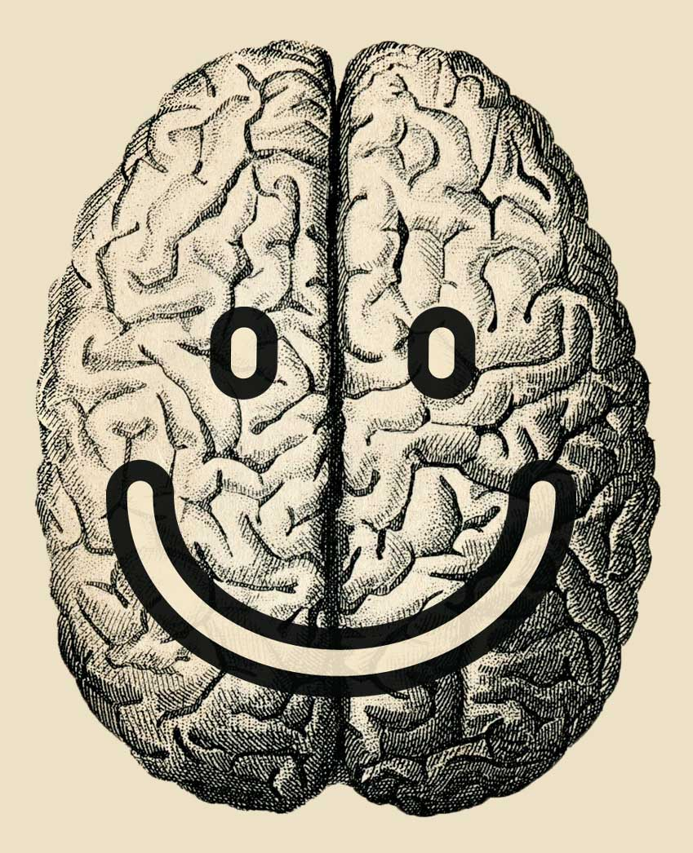
Not All Activity is Bad…
Exercise can improve attention, processing speed, memory and executive functions
Exercise promotes neuroplasticity and neurogenesis
Exercise can improve sleep, reduce pain and relieve headaches
Exercise can improve mood and increase a sense of well-being

Slide 39
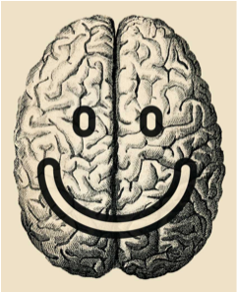
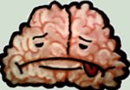
It’s a Balance…
Too
much,
Too early
Cerebral “steal”
Enough,
Right
time

Slide 40
Return to School BEFORE Return to Play……….

Slide 41

“Returning to Learning Following a Concussion.” Council on Sports Medicine and Fitness, and Council on School Health. Pediatrics 2013;132:948-957.

Slide 42
Return to School
The following may be recommended until symptoms are minimal (or resolved) to help expedite recovery
  Postponing tests
  Allowing extra time for tests/quizzes
  Reducing school hours
  Allowing breaks between classes
  Delaying assignments

Slide 43

Return to School
Monitor for recurrence of symptoms with increased cognitive exertion
Prolonged symptoms may benefit from further special services such as a Section 504 Plan

Slide 44
The “Return To Learning” Team
Family Team
  Student, parents, teammates, friends
Medical Team
  Emergency Department, Primary Care Physician, Neurologist, Athletic Trainer, others
School Academic Team
  Teachers, counselor, social worker, administrators
School Physical Activity Team
  Athletic Trainer, Coach, PE Teacher

Slide 45
Signs and Symptoms of a Concussion and the Strategies to Help in the School Setting
Headache
  Frequent breaks
  Identifying aggravators and reducing exposure to them
  Rests, planned or as needed, in nurses office or quiet area
Dizziness
  Allow student to put head down if symptoms worsen
  Give student early dismissal from class and extra time to get from class to class to avoid crowded hallways
Visual symptoms: light sensitivity, double vision, blurry vision
  Reduce exposure to computers, smart boards, videos
  Reduce brightness on the screens
  Allow the student to wear a hat or sunglasses in school
  Consider use of audiotapes of books
  Turn off fluorescent lights as needed
  Seat student closer to the center of classroom activities (blurry vision)
  Cover 1 eye with patch/tape 1 lens if glasses are worn (double vision)
Noise sensitivity
  Allow the student to have lunch in quiet area with a classmate
  Limit or avoid band, choir, or shop classes
  Avoid noisy gyms and organized sports practices/games
  Consideration of the use of earplugs
  Give student early dismissal from class and extra time to get from class to class to avoid crowded hallways during pass time
Difficulty concentrating or remembering
  Avoid testing or completion of major projects during recovery when possible
  Provide extra time to complete nonstandardized tests
  Postpone standardized testing (may require that 504 plan is in place)
  Consider 1 test per day during exam periods
  Consider the use of preprinted notes, note taker, scribe, or reader for oral test taking
Sleep disturbances
  Allow for late start or shortened school day to catch up on sleep
  Allow rest breaks

Slide 46
Signs and Symptoms of a Concussion and the Strategies to Help in the School Setting
Headache
  Frequent breaks
  Identifying aggravators and reducing exposure to them
  Rests, planned or as needed, in nurses office or quiet area
Dizziness
  Allow student to put head down if symptoms worsen
  Give student early dismissal from class and extra time to get from class to class to avoid crowded hallways
Visual symptoms: light sensitivity, double vision, blurry vision
  Reduce exposure to computers, smart boards, videos
  Reduce brightness on the screens
  Allow the student to wear a hat or sunglasses in school
  Consider use of audiotapes of books
  Turn off fluorescent lights as needed
  Seat student closer to the center of classroom activities (blurry vision)
  Cover 1 eye with patch/tape 1 lens if glasses are worn (double vision)
Noise sensitivity
  Allow the student to have lunch in quiet area with a classmate
  Limit or avoid band, choir, or shop classes
  Avoid noisy gyms and organized sports practices/games
  Consideration of the use of earplugs
  Give student early dismissal from class and extra time to get from class to class to avoid crowded hallways during pass time
Difficulty concentrating or remembering
  Avoid testing or completion of major projects during recovery when possible
  Provide extra time to complete nonstandardized tests
  Postpone standardized testing (may require that 504 plan is in place)
  Consider 1 test per day during exam periods
  Consider the use of preprinted notes, note taker, scribe, or reader for oral test taking
Sleep disturbances
  Allow for late start or shortened school day to catch up on sleep
  Allow rest breaks

Slide 47
Signs and Symptoms of a Concussion and the Strategies to Help in the School Setting
Headache
  Frequent breaks
  Identifying aggravators and reducing exposure to them
  Rests, planned or as needed, in nurses office or quiet area
Dizziness
  Allow student to put head down if symptoms worsen
  Give student early dismissal from class and extra time to get from class to class to avoid crowded hallways
Visual symptoms: light sensitivity, double vision, blurry vision
  Reduce exposure to computers, smart boards, videos
  Reduce brightness on the screens
  Allow the student to wear a hat or sunglasses in school
  Consider use of audiotapes of books
  Turn off fluorescent lights as needed
  Seat student closer to the center of classroom activities (blurry vision)
  Cover 1 eye with patch/tape 1 lens if glasses are worn (double vision)
Noise sensitivity
  Allow the student to have lunch in quiet area with a classmate
  Limit or avoid band, choir, or shop classes
  Avoid noisy gyms and organized sports practices/games
  Consideration of the use of earplugs
  Give student early dismissal from class and extra time to get from class to class to avoid crowded hallways during pass time
Difficulty concentrating or remembering
  Avoid testing or completion of major projects during recovery when possible
  Provide extra time to complete nonstandardized tests
  Postpone standardized testing (may require that 504 plan is in place)
  Consider 1 test per day during exam periods
  Consider the use of preprinted notes, note taker, scribe, or reader for oral test taking
Sleep disturbances
  Allow for late start or shortened school day to catch up on sleep
  Allow rest breaks

Slide 48
Signs and Symptoms of a Concussion and the Strategies to Help in the School Setting
Headache
  Frequent breaks
  Identifying aggravators and reducing exposure to them
  Rests, planned or as needed, in nurses office or quiet area
Dizziness
  Allow student to put head down if symptoms worsen
  Give student early dismissal from class and extra time to get from class to class to avoid crowded hallways
Visual symptoms: light sensitivity, double vision, blurry vision
  Reduce exposure to computers, smart boards, videos
  Reduce brightness on the screens
  Allow the student to wear a hat or sunglasses in school
  Consider use of audiotapes of books
  Turn off fluorescent lights as needed
  Seat student closer to the center of classroom activities (blurry vision)
  Cover 1 eye with patch/tape 1 lens if glasses are worn (double vision)
Noise sensitivity
  Allow the student to have lunch in quiet area with a classmate
  Limit or avoid band, choir, or shop classes
  Avoid noisy gyms and organized sports practices/games
  Consideration of the use of earplugs
  Give student early dismissal from class and extra time to get from class to class to avoid crowded hallways during pass time
Difficulty concentrating or remembering
  Avoid testing or completion of major projects during recovery when possible
  Provide extra time to complete nonstandardized tests
  Postpone standardized testing (may require that 504 plan is in place)
  Consider 1 test per day during exam periods
  Consider the use of preprinted notes, note taker, scribe, or reader for oral test taking
Sleep disturbances
  Allow for late start or shortened school day to catch up on sleep
  Allow rest breaks

Slide 49
Signs and Symptoms of a Concussion and the Strategies to Help in the School Setting
Headache
  Frequent breaks
  Identifying aggravators and reducing exposure to them
  Rests, planned or as needed, in nurses office or quiet area
Dizziness
  Allow student to put head down if symptoms worsen
  Give student early dismissal from class and extra time to get from class to class to avoid crowded hallways
Visual symptoms: light sensitivity, double vision, blurry vision
  Reduce exposure to computers, smart boards, videos
  Reduce brightness on the screens
  Allow the student to wear a hat or sunglasses in school
  Consider use of audiotapes of books
  Turn off fluorescent lights as needed
  Seat student closer to the center of classroom activities (blurry vision)
  Cover 1 eye with patch/tape 1 lens if glasses are worn (double vision)
Noise sensitivity
  Allow the student to have lunch in quiet area with a classmate
  Limit or avoid band, choir, or shop classes
  Avoid noisy gyms and organized sports practices/games
  Consideration of the use of earplugs
  Give student early dismissal from class and extra time to get from class to class to avoid crowded hallways during pass time
Difficulty concentrating or remembering
  Avoid testing or completion of major projects during recovery when possible
  Provide extra time to complete nonstandardized tests
  Postpone standardized testing (may require that 504 plan is in place)
  Consider 1 test per day during exam periods
  Consider the use of preprinted notes, note taker, scribe, or reader for oral test taking
Sleep disturbances
  Allow for late start or shortened school day to catch up on sleep
  Allow rest breaks

Slide 50

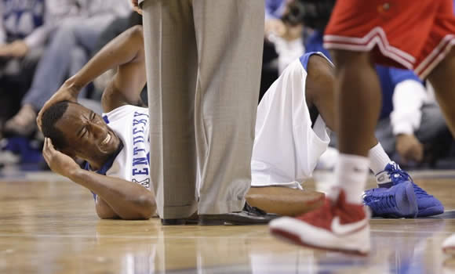
Return to School & Play
Risk Factors for Prolonged Recovery
Gender
Age
Concussion history
Comorbid Conditions
Injury mechanism
Prolonged LOC

Slide 51

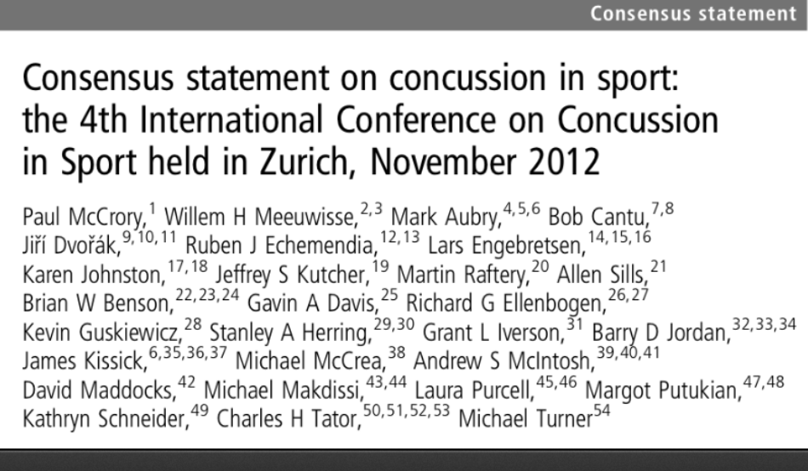

Slide 52
2012 Zurich Return to Play Protocol
Rehabilitation stage | Functional exercise at each stage | Objective of each stage
1. No Activity | Symptom limited physical and cognitive rest | Recovery
2. Light aerobic exercise | Walking, Swimming, Stationary Bike, HR<70% Maximum | Increase heart rate
3. Sport-specific Exercise | Skating or Running Drills. No head impact activities | Add Movement
4. Non-contact training | More complex training drills May start progressive resistance training. | Exercise, coordination, and cognitive load
5. Full-contact practice | Normal training following medical clearance | Restore confidence
6. Return to Play | Game Play

Slide 53

Return to Skating after concussion
Asymptomatic on land, then…
Progress through initial return-to-play on land, then…
Return to the ice using the following sport specific sequence
  1. Stroking
  2. Choreography
  3. Singles/doubles
  4. Triples/spins

Slide 54
Conclusions
Each concussion and each patient’s differences warrants individualized approach
Students with a concussion benefit from academic accommodations after injury
Multi-disciplinary input is often necessary in the patient’s recovery
Students should be performing at their academic baseline prior to return to sports

Slide 55

Thank You!
tad.seifert@nortonhealthcare.org

